Slide 1



Association of Certified Fraud Examiners 12th Annual African Conference and Exhibition.
THEME: EXPOSING THE FRAUDSTER WITHIN.
UNDERSTANDING HUMAN ELEMENTS
CHARACTER THEORY / CHARACTER DNA MODEL
BY LAST MAPURANGA (DIP ACC, MIPI, ACFE, TSCM) founder and senior partner of
.

Slide 2
Profiling A Fraudster Through Individualisation Investigative Technique(Character Theory).
.

Slide 3
Individualisation:
it refers to distinguishing or identification of an individual within a group or species through unique
peculiarities and characteristics.
.

Slide 4
Identification
is the collective aspect of the distinctive characteristics by which a subject is recognised.
.

Slide 5


CHARACTER THEORY / CHARACTER MODEL.
.

Slide 6
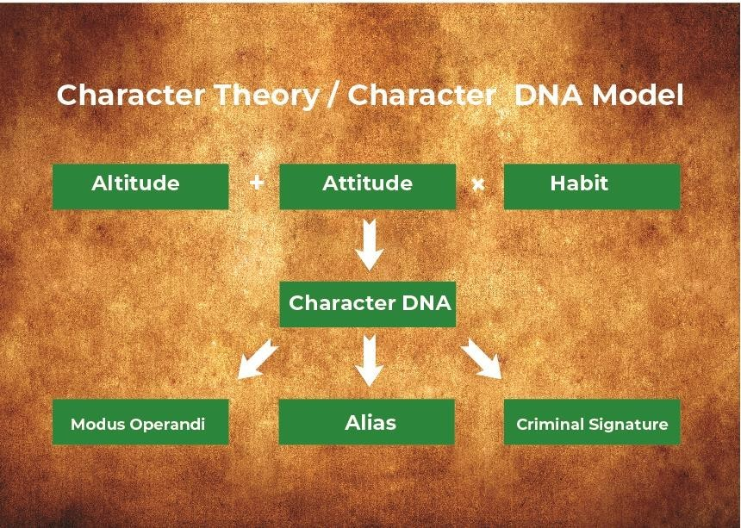

Slide 7

1.CHARACTER:
It refers to the men’s rea and moral being distinctive to an individual.
.

Slide 8

2.DEOXYRIBONUCLEIC ACID (DNA
It refers to that fundamental, essential and distinctive characteristics embedded in someone which is unchangeable or likely not changeable.
.

Slide 9
Therefore, Character Theory or Character DNA states that a human element become what he is through attitude and altitude being reinforced by habit and this will give rise to those distinguished and distinctive unique criminal attributes which can be identified though modus operandi, ali. as and criminal behaviour/signature.

Slide 10
Character DNA/Character theory
(Altitude + Attitude) Habit
.

Slide 11

Altitude:
in respect to a human element means the feelings, self-esteem, identity one feels by doing a certain act or by associating with a certain group or love of people.
.

Slide 12

Attitude:
is the complex mental state involving beliefs, feelings, values and dispositions to act in a certain way. For example, Seventh Day Adventist, they do. not cook or do any type of work on the Sabbath day across the world.

Slide 13
HABIT
are brains thoughts, formed through series of subconscious patterns, which occur out of repetitive acts.
.

Slide 14
However, habit maybe influenced by certain internal forces like fear, alcohol etc. and it should be noted that once these repetitive acts are stored in the brain, they will be repeated within a certain margin of variations every time.
.

Slide 15
“Chains of habit are too light to be felt until they are too heavy to be broken” Warren Buffet.
.

Slide 16
Therefore, character DNA gives rise to:
1.Modus operandi 2.Alias
3.Criminal signature
.

Slide 17
These are signs and symptoms, which
assist in individualisation and in identification of unique human element identity.
.

Slide 18
As a Fraud Examiner, you should be in a position to study, collate and analyse these signs and symptoms in order to nail or exonerate a subject (fraudster. ).

Slide 19

Modus operandi
is the familiar habit or a particular way of doing things by an individual psychologically and emotionally.
.

Slide 20

CRIMINAL SIGNATURE:
refers to the behaviour shown by a criminal during commission of the offense though this is mostly notable in violent crimes; in white colour crimes, they can also be depicted/
noticeable.
.

Slide 21
For example, if a fraudster has a character of stealing money below
R10 000 you easily identify and link
.
him if you collate study and analyse the amounts, e.g. R9999.

Slide 22
Please take note there is thin line between behaviour signature and modus operandi.
.

Slide 23
Example
In what has become India’s largest scandal, Satyam Computer Services Limited founder and Chairman, B Ramalinga Rayu, suddenly quit in January 2009, confessing that he had falsified company accounts for several years.
.

Slide 24
In his four and a half page resignation letter, Rayu revealed he had overstated the company’s reported cash. balance by $1 billion.

Slide 25
Since altitude is the feelings, self-esteem and identity one feels by associating with certain group of people, the Chairman Mr B Ramalinga Rayu has perpetrate financial statement fraud in order to avoid negative market perceptions and cover his inability to generate cash. flows.

Slide 26
On the other hand there was also the issue of the complex mental state involving his beliefs that he is a par excellence Leader who is able to increase company’s earing per share.
.

Slide 27
He further revealed that he had overstated the company’s reported cash balance by $1 billion and he had falsified company accounts for years, meaning to say it was now a habit which now leads to his character DNA th. erefore character theory.

Slide 28
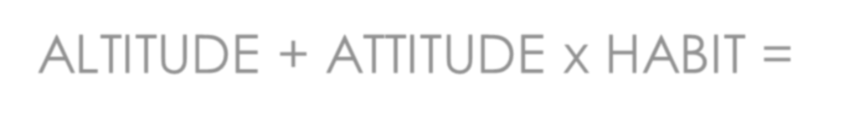


ALTITUDE + ATTITUDE x HABIT = CHARACTER THEORY/ CHARACTER DNA MODEL
.

Slide 29

Alias:
refers to false and assumed identity due to criminology.
.

Slide 30



I THANK YOU FOR YOUR VALUABLE TIME TO LISTEN.
.

Slide 31
BLESS YOU
GOD.

Slide 32





END OF THE
PRESENTATION…..!!
.

